Slide 1
Routing

Slide 2
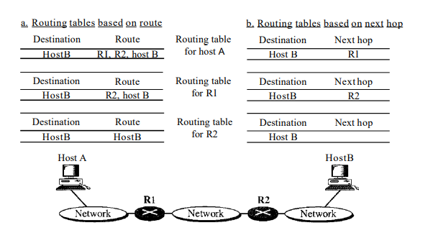
DELIVERY
Direct Vs Indirect Delivery
Forwarding
Forwarding means to place the packet in its route to its destination
Next hop or router with a routing table
Forwarding Techniques
Next-Hop Method Versus Route Method

Slide 3
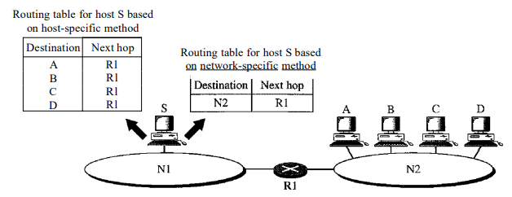

Slide 4
Routing Protocol
ARPANET
Autonomous System or domain
An Autonomous System (AS) is a set of Internet routable IP prefixes belonging to a network or a collection of networks that are all managed, controlled and supervised by a single entity or organization.
An AS utilizes a common routing policy controlled by the entity.
The AS is assigned a globally unique 16 digit identification number一known as the autonomous system number or ASN一by the Internet Assigned Numbers Authority (IANA).

Slide 5
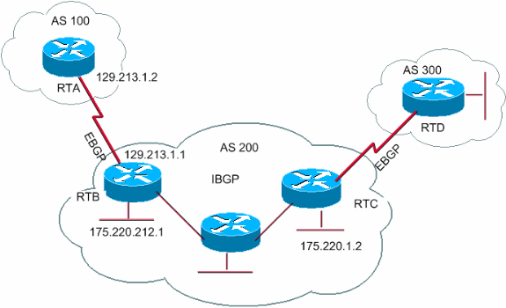
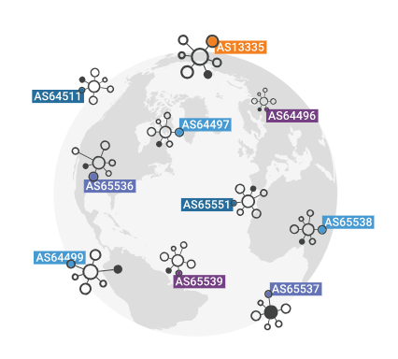
According to some estimates, there are over 90,000 ASNs in use worldwide.

Slide 6
Multihomed
This is an AS that interconnects with two or more external autonomous systems.
Transit
This is an AS that acts as a link between two or more external autonomous systems.
Single-homed (stub)
This is an AS that interconnects with only one external AS.

Slide 7
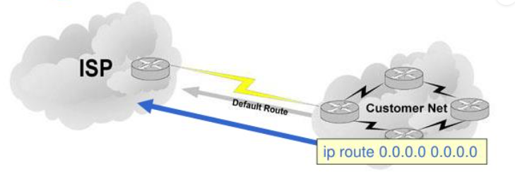
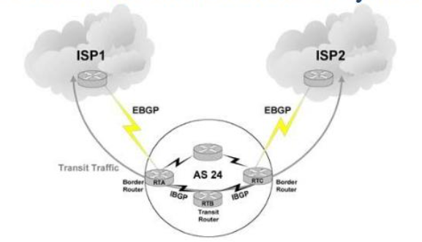
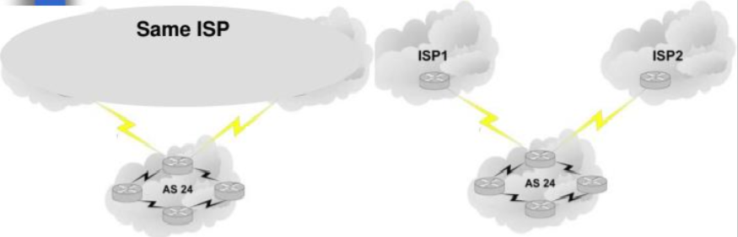

Slide 8
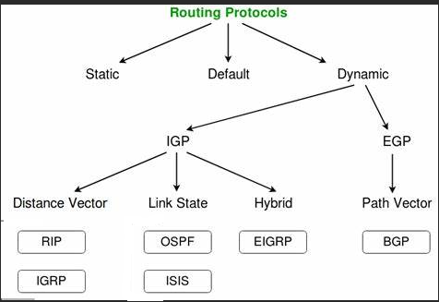

Slide 9
Interior Gateway Protocol
RIP
OSPF
IS-IS
Exterior Gateway Protocol
EGP
BGP

Slide 10
Routing Information Protocol
Routing Information Protocol (RIP) is a distance vector protocol that uses hop count as its primary metric
RIP defines how routers should share information when moving traffic among an interconnected group of local area networks

Slide 11
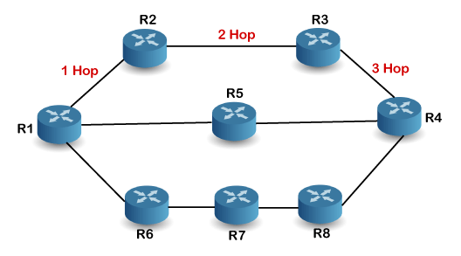
How is hop count determined?
When the router sends the packet to the network segment, then it is counted as a single hop
RIP can support maximum upto 15 hops, which means that the 16 routers can be configured in a RIP

Slide 12
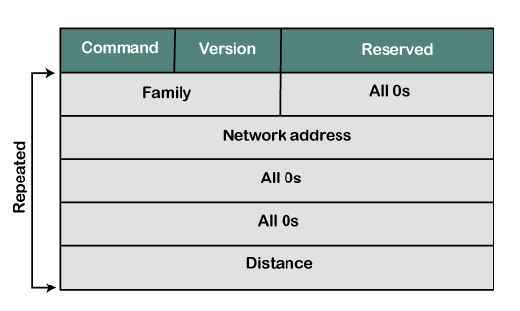
RIP Message Format
Command: It is an 8-bit field that is used for request or reply. The value of the request is 1, and the value of the reply is 2.
Version: Here, version means that which version of the protocol we are using. Suppose we are using the protocol of version1, then we put the 1 in this field.
Reserved: This is a reserved field, so it is filled with zeroes.
Family: It is a 16-bit field. As we are using the TCP/IP family, so we put 2 value in this field.
Network Address: It is defined as 14 bytes field. If we use the IPv4 version, then we use 4 bytes, and the other 10 bytes are all zeroes.
Distance: The distance field specifies the hop count, i.e., the number of hops used to reach the destination.

Slide 13
How Routing Information Protocol works
RIP uses a distance vector algorithm
Each RIP router maintains a routing table, which is a list of all the destinations the router knows how to reach
Each router broadcasts its entire routing table to its closest neighbors every 30 seconds
The neighbors, in turn, pass the information on to their nearest neighbors, and so on, until all RIP hosts within the network have the same knowledge of routing paths. This shared knowledge is known as convergence.
If a router receives an update on a route, and the new path is shorter, it will update its table entry with the length and next-hop address of the shorter path.
If the new path is longer, it will wait through a "hold-down" period to see if later updates reflect the higher value as well. It will only update the table entry if the new, longer path has been determined to be stable.
If a router crashes or a network connection is severed, the network discovers this because that router stops sending updates to its neighbors, or stops sending and receiving updates along the severed connection.
If a given route in the routing table isn't updated across six successive update cycles (that is, for 180 seconds) a RIP router will drop that route and let the rest of the network know about the problem through its own periodic updates.

Slide 14
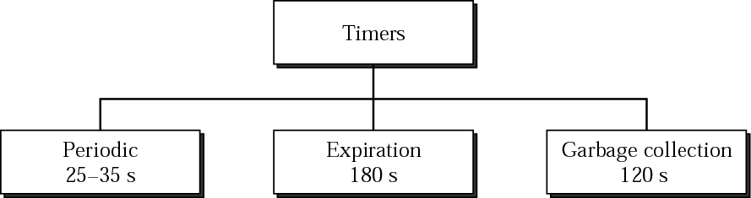
RIP timers
Periodic timer: control advertising of regular update messages (25-35 sec)
Expiration timer: governs the validity of a route (180 sec)
Every time an update (on a 30 sec average) is received the timer is reset
If no update received within this timer the metric is set to 16
Garbage timer: 120 sec
A route can be advertised with a 16 metric for 120 sec before it get purged
Allow neighbors to have knowledge of the invalidity of a route

Slide 15
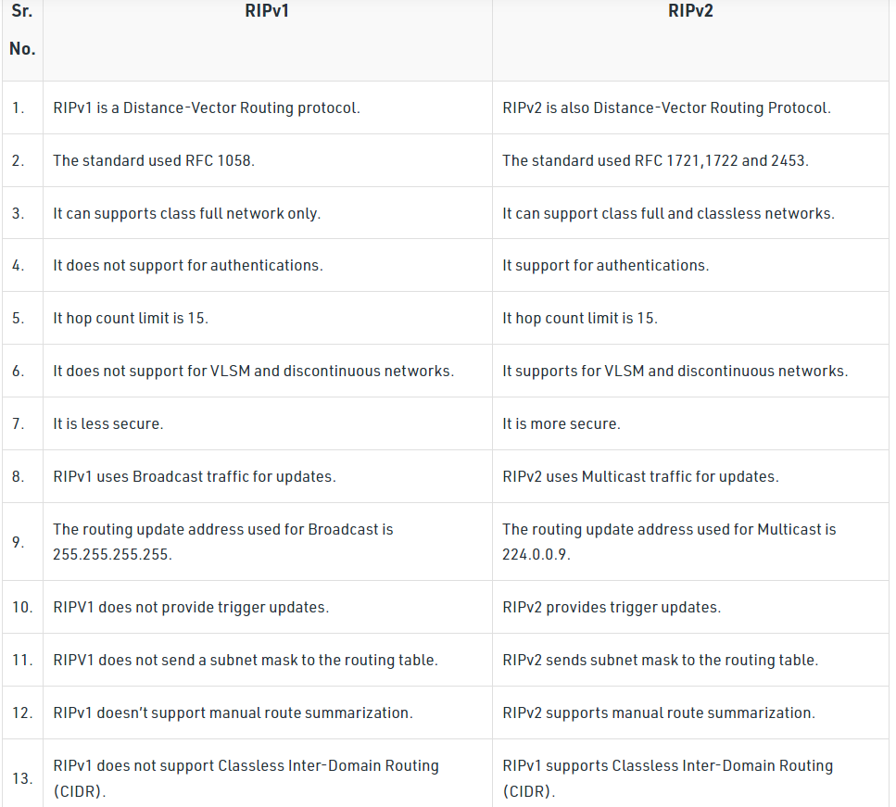

Slide 16
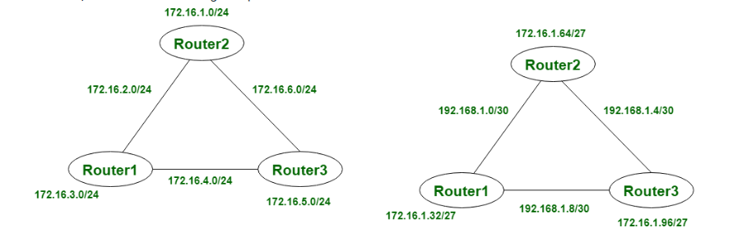
Classful Routing: Classful Routing does not import subnet mask. And in this also subnet mask is provided after the route update. In classful routing, subnet mask is same throughout, does not vary for all devices, we can see it in the given picture. In classful routing, VLSM (Variable Length Subnet Mask) is not supported and also CIDR (Classless Inter-Domain Routing).
Classless Routing: Classless Routing imports subnet mask and in this, triggered updates are used. In classless routing, VLSM (Variable Length Subnet Mask) is supported and also CIDR (Classless Inter-Domain Routing). In classless routing, hello messages are used for checking status. In classless routing, subnet mask is not same throughout, it may vary for all devices, we can see it in the given picture.

Slide 17
Advantages of RIP
feasible configuration
easy to understand
predominantly loop-free
guaranteed to support almost all routers
Promotes load balancing
Disadvantages of RIP
Unfortunately, the disadvantage of RIP is its increased network and processing overhead when compared to static routing.
Other disadvantages of RIP include the following:
not always loop-free
only supports equal-cost load balancing
pinhole congestion can occur
bandwidth-intensive and inefficient
large networks lead to slow convergence

Slide 18
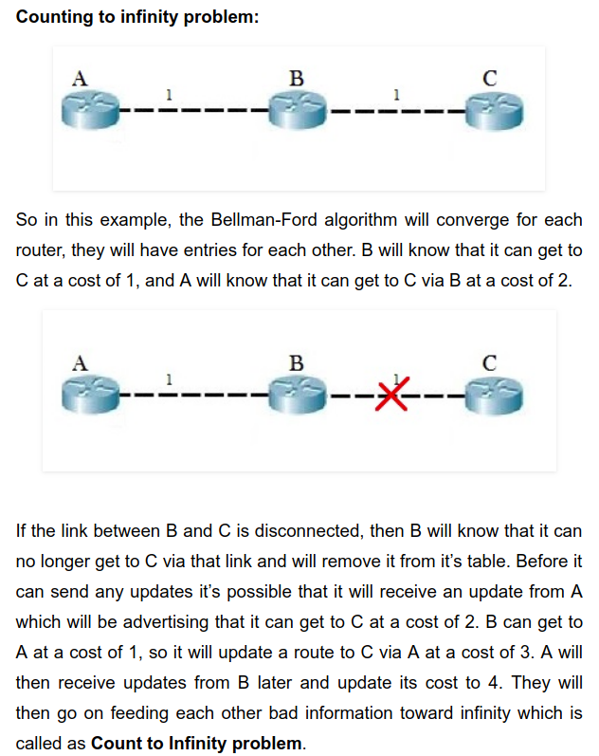

Slide 19
Route Poisoning: When a route fails, distance vector protocols spread the bad news about a route failure by poisoning the route. Route poisoning refers to the practice of advertising a route, but with a special metric value called Infinity. Routers consider routes advertised with an infinite metric to have failed. Each distance vector routing protocol uses the concept of an actual metric value that represents infinity. RIP defines infinity as 16. The main disadvantage of poison reverse is that it can significantly increase the size of routing announcements in certain fairly common network topologies.

Slide 20
EGP
used to exchange net-reachability information between Internet gateways belonging to the same or different autonomous systems
RFC 827 and RFC 904
focused on network reachability and does not consider any metrics to calculate the best path
Basically used in APRANET to communicate reachability to Core router to AS
EGP has three major functions:
Establish a set of neighbours
Check status of neighbours(if they are alive/reachable)
Inform neighbours the networks that reachable within their AS’s

Slide 21
Neighbor Acquisition Request | Used by exterior gateways to request to become neighbors of each other.
Neighbor Acquisition Reply | Used by exterior gateways to accept the request to become neighbors.
Neighbor Acquisition Refusal | Used by exterior gateways to deny the request to become neighbors. The refusal message includes reasons for refusal, such as out of table space.
Neighbor Cease | Used by exterior gateways to cease the neighbor relationship. The cease message includes reasons for ceasing, such as going down.
Neighbor Cease Acknowledgment | Used by exterior gateways to acknowledge the request to cease the neighbor relationship.
Neighbor Hello | Used by exterior gateways to determine connectivity. A gateway issues a Hello message and another gateway issues an I Heard You message.
I Heard You | Used by exterior gateways to reply to a Hello message. The I Heard You message includes the access of the answering gateway and, if the gateway is unreachable, a reason for lack of access, such as You are unreachable because of problems with my network interface.
NR Poll | Used by exterior gateways to query neighbor gateways about their ability to reach other gateways.
Network Reachability | Used by exterior gateways to answer the NR Poll message. For each gateway in the message, the Network Reachability message contains information on the addresses that gateway can reach through its neighbors.
EGP Error | Used by exterior gateways to respond to EGP messages that contain bad checksums or have fields containing incorrect value

Slide 22
BGP
Border Gateway Protocol (BGP) is the postal service of the Internet. When someone drops a letter into a mailbox, the Postal Service processes that piece of mail and chooses a fast, efficient route to deliver that letter to its recipient
RFC 1771 RFC 4271 RFC 9272
TCP port 179

Slide 23
BGP Messages
Open messages are used to establish BGP connections
Update messages are used to transfer routing information between BGP peers
Notification messages are used to notify BGP peers of errors in a BGP process
Keepalive messages are used to maintain BGP connections
Route-refresh messages are used to dynamically request a BGP route advertiser to resend Update messages

Slide 24
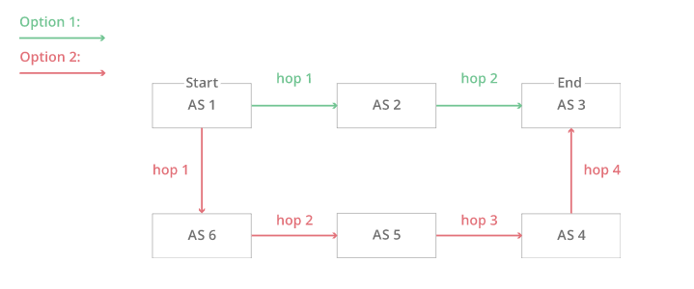
Hopping to AS2 and then to AS3:
AS2 → AS3
Or hopping to AS6, then to AS5, AS4, and finally to AS3:
AS6 → AS5 → AS4 → AS3
Bit Index Explicit Replication (BIER) architecture to find SPF

Slide 25
Internal BGP and External BGP
Routes are exchanged and traffic is transmitted over the Internet using external BGP
Autonomous systems can also use an internal version of BGP to route through their internal networks, which is known as internal BGP (iBGP)
https://www.youtube.com/watch?v=_Z29ZzKeZHc

Slide 26
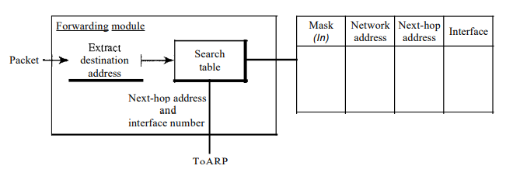
Forwarding Process
In classless addressing, we need at least four columns in a routing table.

Slide 27
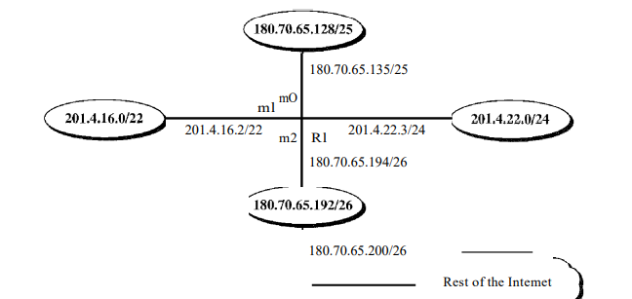

Slide 28
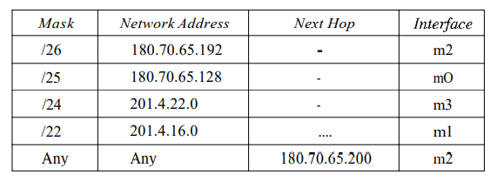
Destination Address : 180.70.65.140
Apply first Mask /26 to the destination IP
180.70.65. 140 …………… > 180.70.65. 10010000
180.70.65. 10000000 ie 180.70.65.128 which in not matching to 180.70.65.192
2 Apply /25 mask on the destination 180.70.65. 140 ……… > 180.70.65. 10010000
Ie 180.70.65. 140 .128 It matches with the network address and Interface Mo is passed to ARP further processing
7 | 6 | 5 | 4 | 3 | 2 | 1 | 0
128 | 64 | 32 | 16 | 8 | 4 | 2 | 0

Slide 29
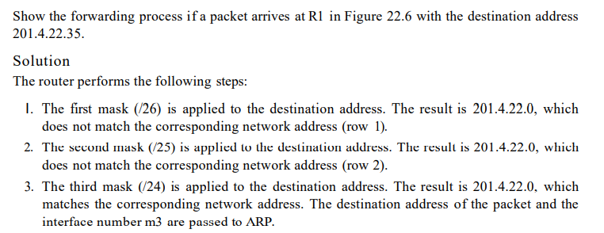

Slide 30
https://itexamanswers.net/ccna-3-v5-0-3-v6-0-chapter-5-exam-answers-100-full.html

Slide 31
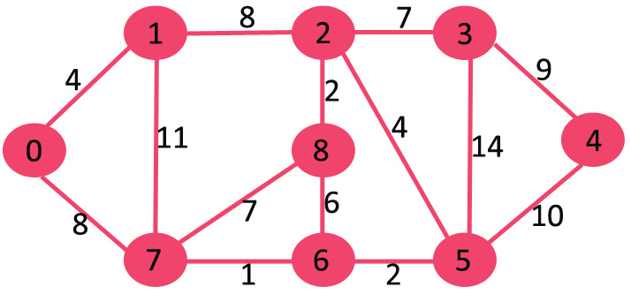
OSPF Protocol

Slide 33
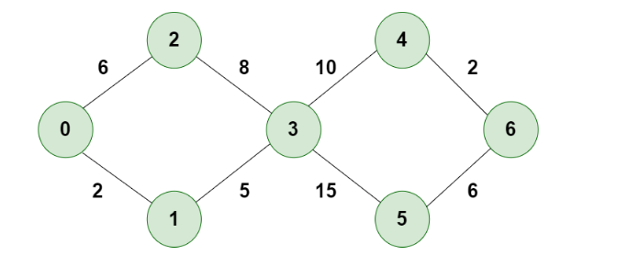
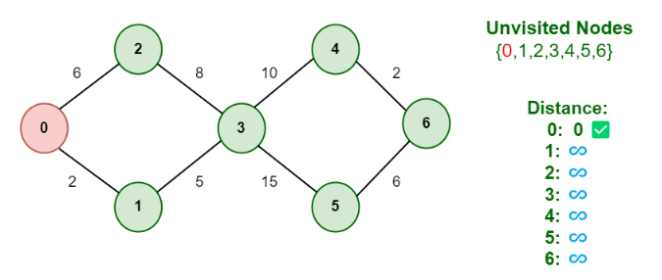
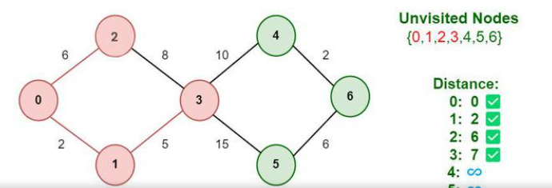

Slide 34
OSPF (Open Shortest Path First) is a link state routing protocol. Because it is an open standard, it is implemented by a variety of network vendors.
a classless routing protocol
supports VLSM, CIDR, manual route summarization, equal cost load balancing
incremental updates are supported
uses only one parameter as the metric – the interface cost.
the administrative distance of OSPF routes is, by default, 110.
uses multicast addresses 224.0.0.5 and 224.0.0.6 for routing updates.

Slide 35
Each OSPF router stores routing and topology information in three tables:
Neighbor table – stores information about OSPF neighbors
Topology table – stores the topology structure of a network
Routing table – stores the best routes

Slide 36
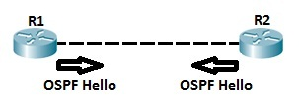
OSPF neighbors
OSPF routers need to establish a neighbor relationship before exchanging routing updates. OSPF neighbors are dynamically discovered by sending Hello packets out each OSPF-enabled interface on a router. Hello packets are sent to the multicast IP address of 224.0.0.5.
The process is explained in the following figure:
The following fields in the Hello packets must be the same on both routers in order for routers to become neighbors:
subnet
area id
hello and dead interval timers 10 Seconds
authentication
area stub flag
MTU

Slide 37
OSPF neighbor states
Before establishing a neighbor relationship, OSPF routers need to go through several state changes. These states are explained below.
1. Init state – a router has received a Hello message from the other OSPF router 2. 2-way state – the neighbor has received the Hello message and replied with a Hello message of his own 3. Exstart state – beginning of the LSDB exchange between both routers. Routers are starting to exchange link state information. 4. Exchange state – DBD (Database Descriptor) packets are exchanged. DBDs contain LSAs headers. Routers will use this information to see what LSAs need to be exchanged. 5. Loading state – one neighbor sends LSRs (Link State Requests) for every network it doesn’t know about. The other neighbor replies with the LSUs (Link State Updates) which contain information about requested networks. After all the requested information have been received, other neighbor goes through the same process 6. Full state – both routers have the synchronized database and are fully adjacent with each other.

Slide 38
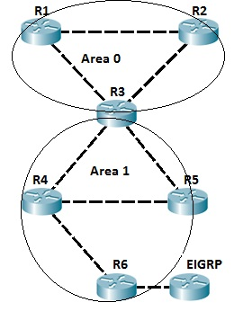

Slide 39
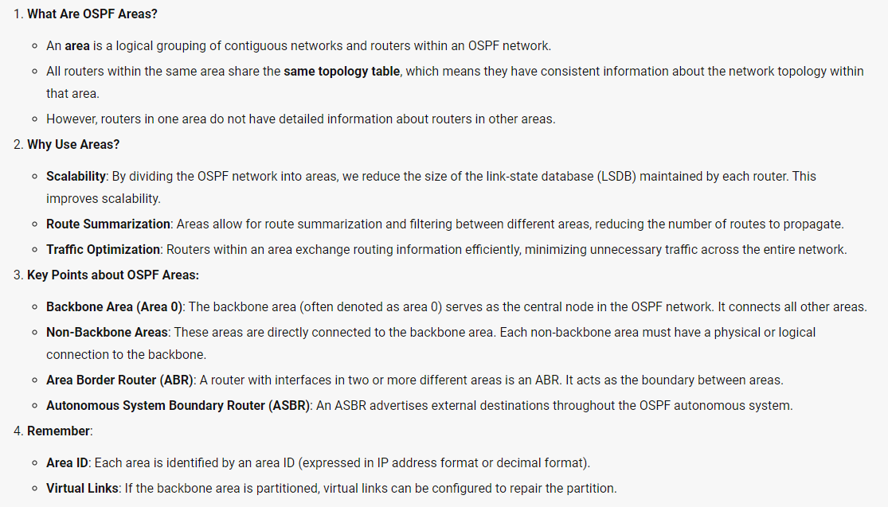

Slide 40
LSA, LSU and LSR
The LSAs (Link-State Advertisements) are used by OSPF routers to exchange topology information. Each LSA contains routing and toplogy information to describe a part of an OSPF network. When two neighbors decide to exchange routes, they send each other a list of all LSAa in their respective topology database. Each router then checks its topology database and sends a Link State Request (LSR) message requesting all LSAs not found in its topology table. Other router responds with the Link State Update (LSU) that contains all LSAs requested by the other neighbor.

Slide 41
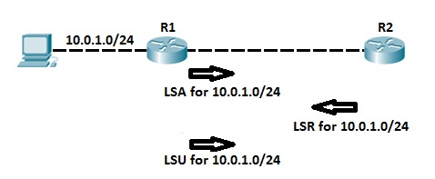
The concept is explained in the following example :

Slide 42
Features | RIP Protocol | OSPF Protocol
Routing Protocol Type | Distance vector routing protocol (uses the distance or hop counts to determine the transmission path) | Link State Routing Protocol (analyzes different sources like the speed, cost, and path congestion while identifying the shortest path)
Network Table Construction | The router consolidates the routing table from the neighboring devices to construct its own routing table and sends it to neighboring devices at a regular interval. | The router consolidates the routing table by getting only required information from the neighboring devices, never gets the entire routing table.
Default Metric | Based on hop count | Based on bandwidth
Hop Count Restriction | RIP protocol allows only up to 15 hops | OSPF protocol has no such restriction
Administrative Distance | 120 | 110
Algorithm Used | Bellman-Ford algorithm | Dijkstra algorithm

Slide 43
Features | RIP Protocol | OSPF Protocol
Network Classification | In RIP, the networks are classified as areas and tables. | In OSPF, the networks are classified as areas, sub-areas, autonomous systems, and backbone areas.
Complexity Level | relatively simpler | much more complex
Network Application | RIP suits better for smaller networks as it has hop count restrictions | OSPF serves great for larger networks
Design | Flat network | Hierarchical network possible
Convergence Time | Slow | Fast
Device Resource Requirements | Much less memory and CPU intensive than OSPF | Memory and CPU intensive
Network Resource Requirements | Bandwidth consuming; whole routing table is sent | Less than RIP; only small updates are sent

Slide 44
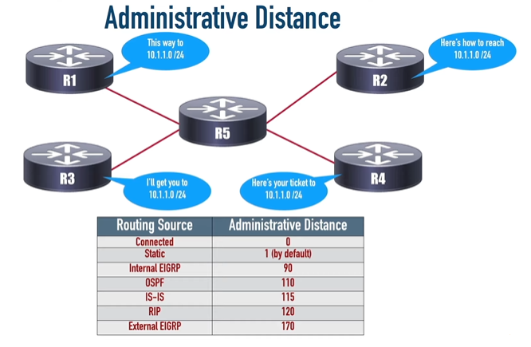

Slide 45
